Slide 1

Programming Principles
1811ICT/2807ICT/7001ICT
Week 6 Lecture
Dr Mardé Helbig

Slide 2


Recap: for loop
You want to determine the average of a student’s grades for their courses completed so far. Prompt the student for their grade until a negative grade is entered. Print out the number of grades entered and the student’s average grade.
How will we change this problem to solve it with a for loop instead of a while loop?
You want to determine the average of a student’s grades for their courses completed so far. Prompt the student for the number of grades they want to enter and then prompt them for those grades. Print out the number of grades entered and the student’s average grade.
What are key differences here? Why?

Slide 3
Recap: for loop problem solving
You want to determine the average of a student’s grades for their courses completed so far. Prompt the student for the number of grades they want to enter and then prompt them for those grades. Print out the number of grades entered and the student’s average grade.
# forLoop7.py
# changing grade example using for loop
#determine how many grades will be entered
gradeNumber = int(input(“How many grades will be entered: “))
total = 0 #sum of the grades
#using the for loop
for i in range(gradeNumber):
grade = float(input(“Enter a grade: “))
total += grade
print(“Number of grades: “, gradeNumber)
print(“Grade average: “, (total/gradeNumber))

Slide 4
Control and Data
Section 14: PASS, break, continue

Slide 5

control statements – pass, break, continue
These 3 control statements are used in the bodies of other control statements (such as if, for and while) to change their normal behaviour
But why? And how?

Slide 6
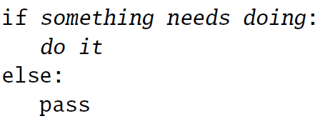
null operation – pass statement
The pass statement does nothing
Used as a placeholder where a statement is required but nothing should be done
For example:
# passStatement.py
# illustrate usage of pass statement
numbers = [0, 1, 2, 3]
for n in numbers:
if (not n):
pass #do nothing if n is 0
else:
n += 2
print(n) #print the result
>>> python passStatement.py
0
3
4
5

Slide 7
Break statement
The break statement terminates the execution of the loop body it occurs in, AND the loop itself
Most useful in for loops that achieve their aim before reaching the end of the sequence
Should be placed inside a selection inside the loop
# breakStatement.py
# illustrate usage of break statement
numbers = [0, 1, 2, 3]
for n in numbers:
if (n == 1): #if (not n): nothing. Why?
break #exits body of loop and loop
else:
n += 2
print(n) #print the result
>>> python breakStatement.py
2

Slide 8
Continue statement
The continue statement terminates the current execution of the loop body it occurs in, but NOT the loop
It skips to the next iteration of the loop
Should be placed inside a selection inside the loop
# continueStatement.py
# illustrate usage of continue statement
numbers = [0, 1, 2, 3]
for n in numbers:
if (not n):
continue #exits body of loop, skips to next iteration
else:
n += 2
print(n) #print the result
>>> python continueStatement.py
3
4
5

Slide 9

Break statement – BAD practice
# averageGradeWhile.py - calculates the average grade
#sentinel pattern
#read first value
grade = float(input(“Enter a grade (negative value to stop): “))
#check value against condition – not sentinel value
sum = 0
num = 0
while (True):
#repeat the following statements
#what do we do with value?
#why here? why not after reading?
if (grade < 0):
break
sum += grade
num += 1
#read next value
grade = float(input(“Enter a grade (negative value to stop): “))
#print out results (number of grades entered and average)
print(“Number of grades: “, num)
print(“Average grade: “, sum/num)
# averageGradeFor.py - calculates the average grade
#sentinel pattern
#read first value
grade = float(input(“Enter a grade (negative value to stop): “))
#check value against condition – not sentinel value
sum = 0
num = 0
while (grade >= 0):
#repeat the following statements
#what do we do with value?
#why here? why not after reading?
sum += grade
num += 1
#read next value
grade = float(input(“Enter a grade (negative value to stop): “))
#print out results (number of grades entered and average)
print(“Number of grades: “, num)
print(“Average grade: “, sum/num)

Slide 10

Any questions?
Type your question in the Q&A or raise your hand

Slide 11












Temperature Check
How do you feel about pass, break, continue?

Slide 12
Control and Data
Section 15: Using library functions

Slide 13
Standard Library
We covered the syntax of Python statements
We still need to explore the standard library more
Many kind of things can be found in the standard library:
built-in functions, e.g. abs()
built-in constants, e.g. True
built-in types (classes), e.g. int
constructors of the built-in classes, e.g. int()
methods of the built-in classes, e.g. str.isalpha()
functions, constants and classes imported from modules

Slide 14
Standard Library: reading docs
Do no treat this course’s lecture notes as your sole source of information for learning Python
The online Python documentation is the primary course for Python Programmers
We introduce you to it and enable you to use it

Slide 15
Standard Library: built-in functions
There are functions that are always available for use without importing modules or invoking as methods
Relatively short list of built-in functions
These include:
constructors of types we know, e.g. int, float, str, bool
print and input statements we have used often
other utilities
Look up abs which is handy to know – read the documentation to see how you can use it

Slide 16

Function calls
A call to a function always involves the function’s name and a pair of parentheses
Parentheses enclose zero or more arguments (also called parameters)
# function calls
# REPL examples
>>> a = input(“Enter your name:”) #input function
>>> round(10/6, 2) #round number to 2 digits
>>> print(-42) #print function
# function calls
# script
#functions.py
a = input(“Enter your name:”) #input function
round(10/6, 2) #round number to 2 digits
print(-42) #print function
>>> python functions.py
-42

Slide 17
returned values
In general functions receive values (arguments) and return values when they finish
How can we see the values returned by a function?
# function calls
#returnValues.py
a = input(“Enter your name:”) #input function
round(10/6, 2) #round number to 2 digits
print(-42) #print function
print(abs(-8))
>>> python returnValues.py
-42
8

Slide 18
returned values - none
Which value does print return?
None – a special value in Python meaning no value has been returned by the function (similar to void in other programming languages)
# function calls
# script
#returnValues2.py
print(print(-42))
>>> python returnValues2.py
-42
None
>>>

Slide 19
order of arguments
When a function has more than one argument, the order of arguments is very important
For example, the constructor range can have 1 to 3 arguments
# function calls
# script
#argumentOrder.py
for i in range(1, 3):
print(i)
# function calls
# script
#argumentOrder2.py
for i in range(3, 1):
print(i)
>>> python argumentOrder.py
1
2
>>> python argumentOrder2.py

Slide 20
default arguments
After list of compulsory arguments, there can be optional arguments indicated with a keyword and a default value
Saw this with the print function
# function calls
# script
#defaultArguments.py
for i in range(1, 3):
print(i)
for j in range(1, 3):
print(j, end=“ “)
print()
for k in range(1, 3):
print(k, k*2, sep=“:”, end=“ “)
>>> python defaultArguments.py
1
2
1 2
1:2 2:4
>>>

Slide 21
calling methods
Object-oriented Programming Definitions:
Class: Data type defining attributes (properties/fields) and methods for any objects that are instances of the class.
Attribute: An item of data stored in the instances of the class.
Method: Function that defines operations that can be performed on/with instances of the class.
Members: Attributes and methods of a class.

Slide 22
calling methods
Know now that class also defines methods that can operate on the instances (objects)
In the standard library below the built-in functions, we can find the built-in types (classes):
Will not document attributes – normally private
Documents the methods we can use with each class
Refer to the list of methods of the String class

Slide 23
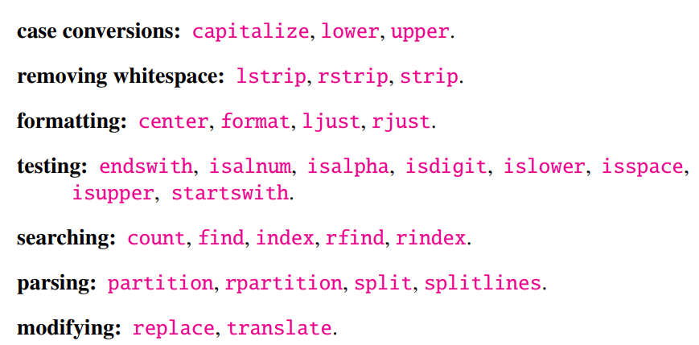
calling methods - String
Most useful methods of String:
How do we call these methods?

Slide 24
calling methods
#calling methods examples
#callingMethods.py
s = “hello”
#normal built-in function
print(“length of”, s, “=“, len(s)) #pass s as argument to the function
#method of str class
print(s.isdigit()) #method is called on instance of str (s) using the member access operator, the period (.)
object is passed as extra argument to the method
isdigit() does not have any other arguments, but some methods do

Slide 25
calling string methods - format
str’s format method:
helps us control the number of decimal places when we print floats
arguments are interpolated into the output string, with {} indicating where it will be interpolated
special sequence of characters in {} controls the conversion of the value to a string
#str.format examples
#REPL
>>> “{} / {} = {}”.format(10, 3, 10/3) #interpolating multiple values in order
’10 / 3 = 3.333333333333’
>>> “{2} {1} {0}”.format(10, 20, 30) #using values out of order
’30 20 10’
>>> “{2:d} {1:d} {0:d}”.format(10, 20, 30) #using values out of order and format them in decimal
’30 20 10’
>>> “{::.3e} {:.3e}”.format(2**20, 2**40) #using values in order in scientific notation with 3 decimal places
‘1.049e+06 1.100e+12’
>>> “{:<10s} {:<20s}”.format(“name:”, “Fred”)
‘name: Fred ‘
>>>

Slide 26
importing modules
Two approaches:
Import qualified – must use class name with method, e.g. math.floor
Import unqualified – can use method name alone, e.g. floor
#ceilFloor1.py
#qualified – must use class name with method
import math
x = 10 / 3
print(“x = {:.4f}”.format(x))
print(“ceil(x) = {:.4f}”.format(math.ceil(x)))
print(“floor(x) = {:.4f}”.format(math.floor(x)))
#ceilFloor2.py
#unqualified – can use method name without class name
from math import ceil, floor
x = 10 / 3
print(“x = {:.4f}”.format(x))
print(“ceil(x) = {:.4f}”.format(ceil(x)))
print(“floor(x) = {:.4f}”.format(floor(x)))
How can we import all methods of a class to use them unqualified?
from math import *

Slide 27
Any questions?
Type your question in the Q&A or raise your hand

Slide 28
Temperature Check
How do you feel about modules and methods?

Slide 29
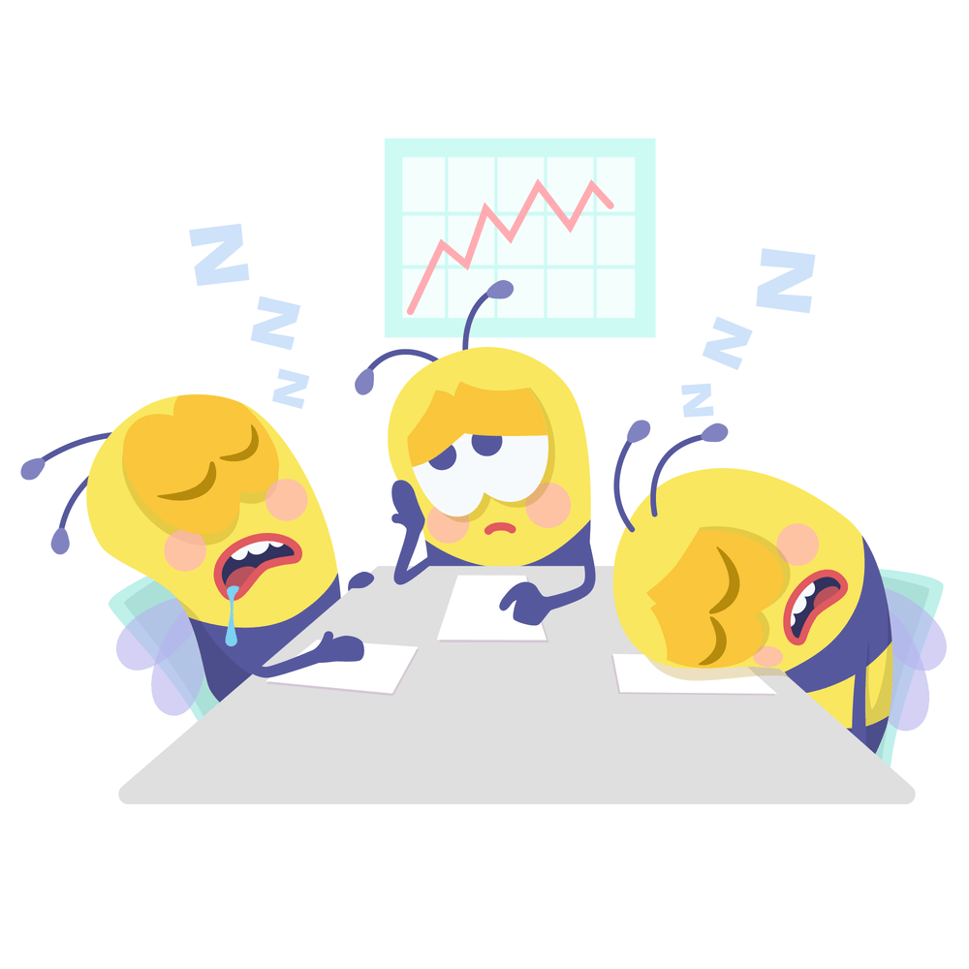
5 Minute Break Time!
Back at 12:18pm

Slide 30
Control and Data
Section 16: defining functions

Slide 31

functions
Encapsulate statements into small packages called subroutines, procedure, functions, or methods to:
re-use code
minimise the number of bugs/errors by simplifying a program
control the flow of statements in another way
maintainability
divide and conquer
recursion

Slide 32


Defining functions
keyword indicating definition of a function
name of your function
arguments passed to function
indicates statements follow
statements part of function
Python is interpretive language – must define function before calling it!

Slide 33
defining functions
#ownFunction.py
#define function without parameters
def printHowdy():
print(“Howdy!”)
#calling function
printHowdy()
printHowdy()
>>> python ownFunction.py
Howdy!
Howdy!
>>>

Slide 34
defining functions with parameters
#ownFunction2.py
#define function with parameters
def printHowdy(name):
“””printing a greeting for a specific person”””
print(“Howdy”, name, “!”)
#calling function
printHowdy(“John”)
printHowdy(“Susan”)
#ownFunction3.py
#define function with parameters
def printVertically(name):
“””printing a string vertically”””
for i in name:
print(i)
#calling function
printHowdy(“John”)
printHowdy(“Susan”)
docstring
>>> python ownFunction2.py
Howdy John !
Howdy Susan !
>>>
docstring is used by the help() function in the REPL

Slide 35
defining functions with return value
#ownFunction4.py
#define function with parameters and returning value
def finalBalance(d, c):
“”” returns the final balance after applying a discount
d is the discount that should be applied as a percentage
c is the cost before applying the discount”””
return d*c
#calling function
finalBalance(10, 120)
b = finalBalance(20, 200)
print(“Discounted balance: AUD”, b)
docstring
>>> python ownFunction4.py
Discounted balance: AUD 160
>>>
docstring is used by the help() function in the REPL

Slide 36
defining functions with default arguments
#ownFunction5.py
#define function with parameters and returning value
def area(length, width=4):
“”” returns the area of a rectangle
length is the length of the rectangle
width is the width of the rectangle”””
return width*length
#calling function
a =area(2, 3)
b = area(2)
print(“Area a =”, a)
print(“Area b = “, b)
docstring
>>> python ownFunction5.py
Area a = 6
Area b = 8
>>>
docstring is used by the help() function in the REPL

Slide 37
Local and global scope of variables
Scope of variable determines the visibility of a variable
Global scope: variable is created and visible outside the function
Local scope: variable is created within the function and visible only within the function

Slide 38
local and global scope of variables
#localScope.py
#define function with local variable
def f():
x = 2
print(“a. x =“, x)
#define global variable
y = 1
f()
print(“b. y =“, y)
print(“c. x =“, x)
>>> python localScope.py
x = 2
y = 1
Traceback (most recent call last):
File "C:\Users\s2989440\Documents\Teaching\Programming Principles\Week6\PP-Week6\localScope.py", line 10, in <module>
print("c. x =", x)
^
NameError: name 'x' is not defined
>>>
What is causing the error?

Slide 39
local and global scope of variables
#globalScope.py
#define function with local variable
def f():
x = 2
print(“a. x =“, x)
print(“b. y =“, y) #global variable
#define global variable
y = 1
f()
print(“c. y =“, y) #global variable
>>> python globalScope.py
x = 2
y = 1
y = 1
>>>
Can we change the value of y in the function?

Slide 40
global eclipsing
#globalEclipsing.py
#define function with local variable
def f():
y = 2
print(“a. y =“, y)
#define global variable
y = 1
f()
print(“b. y =“, y) #global variable
>>> python globalEclipsing.py
y = 2
y = 1
>>>
Variable in function is a local variable and while being used in function the value of global variable with same name is hidden - eclipsed
Don’t use global variables in a function – rather pass value as argument

Slide 41
Lifetime of variables
Local variables go out of scope when function exits AND they cease to exist – Python interpreter can use that memory allocation for other variables
Global variables exist until the end of the program unless they are deleted with del

Slide 42
Scope of parameters
#parametersScope.py
#define function with local variable
def f(x):
print(“b x =“, x)
x += 1
print(“c x =“, x) #global variable
#define global variable
y = 1
print(“a y =“, y) #global variable
f(y)
print(“d y =“, y) #global variable
>>> python parametersScope.py
a y = 1
b x = 1
c x = 2
d y = 1
>>>
What is happening here with the variables?

Slide 43
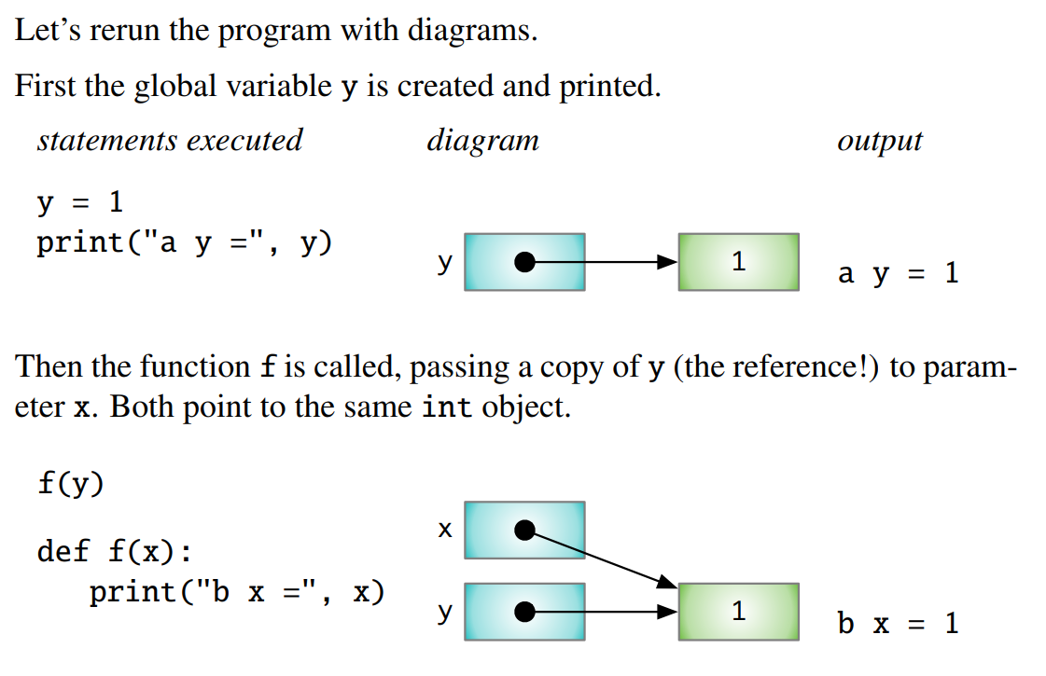
Scope of parameters
#parametersScope.py
def f(x):
print(“b x =“, x)
x += 1
print(“c x =“, x)
#define global variable
y = 1
print(“a y =“, y)
f(y)
print(“d y =“, y)

Slide 44
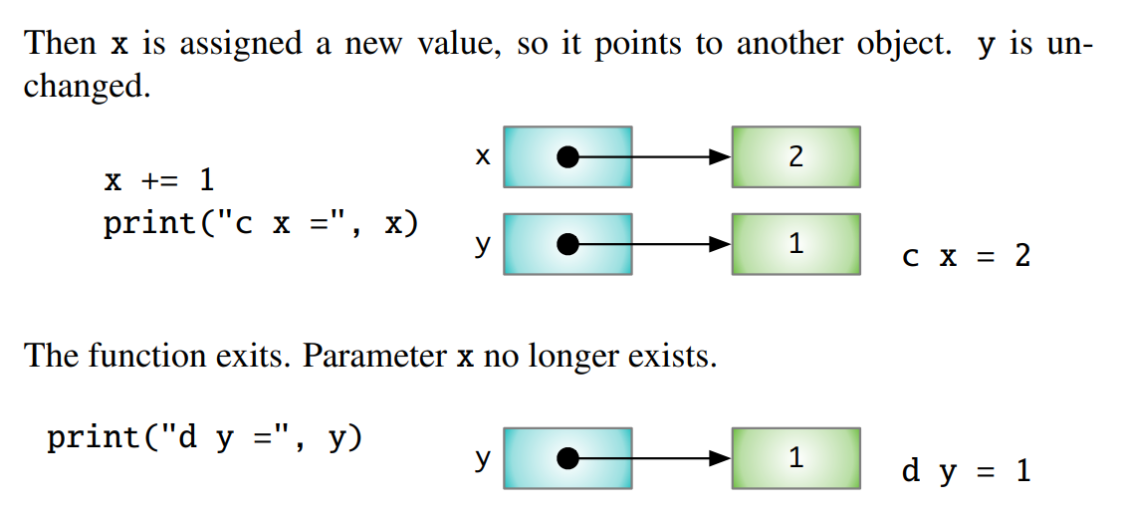
Scope of parameters
#parametersScope.py
def f(x):
print(“b x =“, x)
x += 1
print(“c x =“, x)
#define global variable
y = 1
print(“a y =“, y)
f(y)
print(“d y =“, y)

Slide 45
Any questions?
Type your question in the Q&A or raise your hand

Slide 46
Temperature Check
How do you feel about defining functions and their parameters?

